Slide 1
Customer Segmentation

Slide 2
Members
Ahmed Badawy
Anas Ibrahim
Esmael Ezz
Yousef Shindy

Slide 3
TABLE OF CONTENTS
01
02
03
Problem Formulation
Data Understanding
Data Preprocessing
05
06
Feature Engineering
RFM
04
Data
Visualization
07
08
Modeling
Evaluation

Slide 4

Problem Formulation
Understand the diverse customer base better and create targeted marketing strategies to address the specific needs of each segment

Slide 5
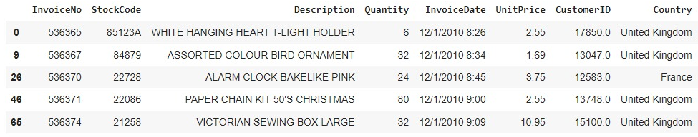

Data Understanding
InvoiceNo
StockCode
Description
Quantity
Invoicedate
UnitPrice
CustomerID
Country

Slide 6
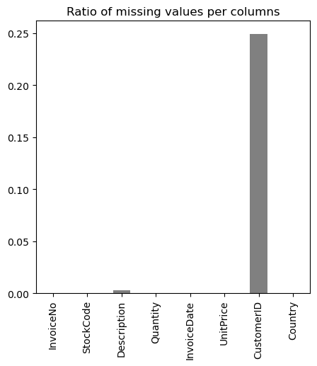

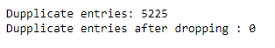
Data Preprocessing
NULL
Duplicates

Slide 7
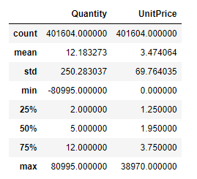
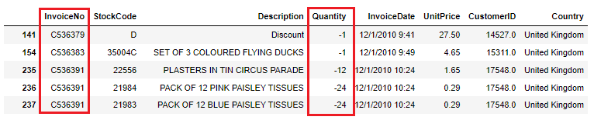
Data Preprocessing
Negative Quantity

Slide 8
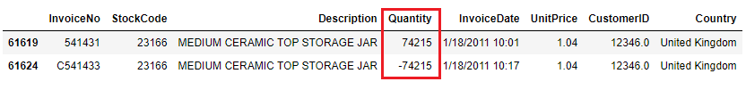
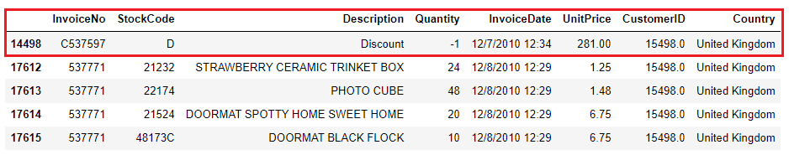
Data Preprocessing
Order Counterpart
Discount

Slide 9
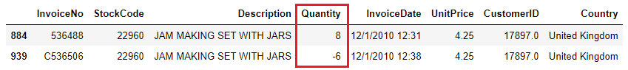
Data Preprocessing
Cancel just a part of the transaction
Quantity Canceled

Slide 10
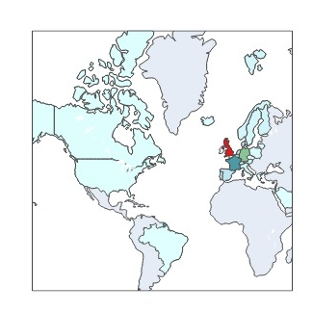
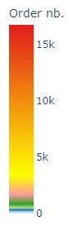
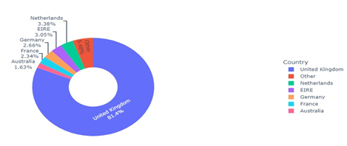
Data Visualization

Slide 11
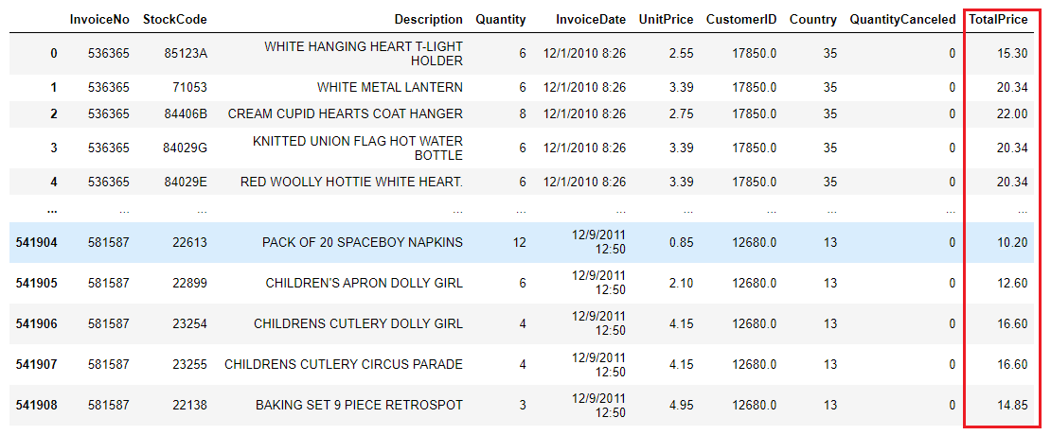

Feature Engineering
Total Price =
Unit Price * (Quantity – Quantity Canceled)

Slide 12
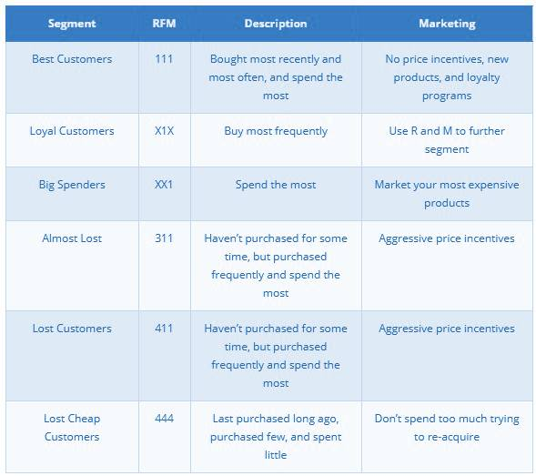
RFM
Groups customers based on their transaction history
How recent, how often, and how much they spent.

Slide 13
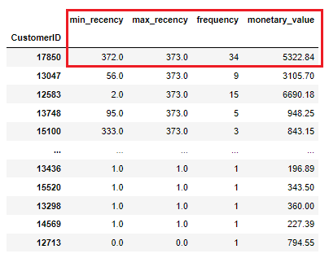
RFM
Applying RFM for each Customer

Slide 14
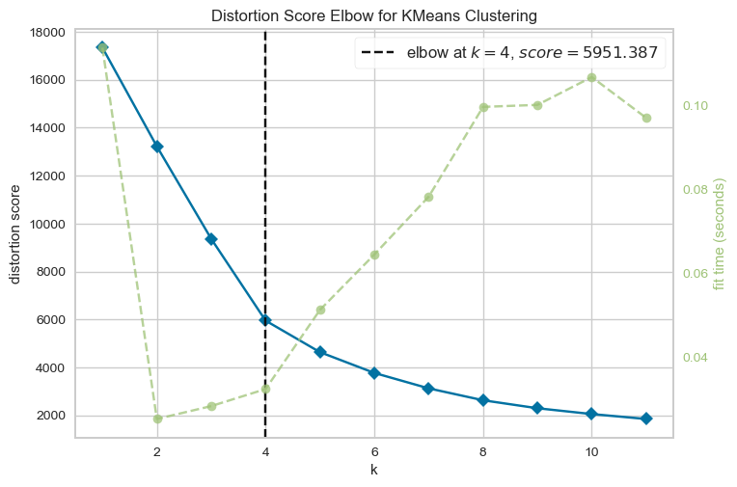
Modeling
K Means
Optimal K = 4
Elbow Method

Slide 15
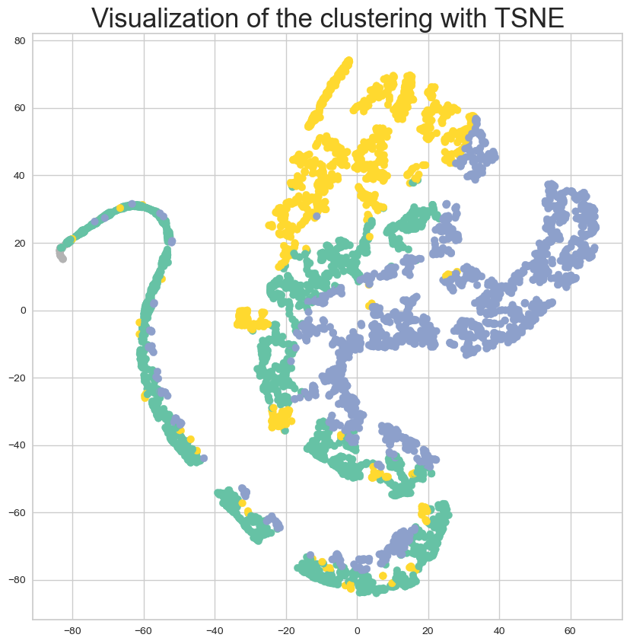
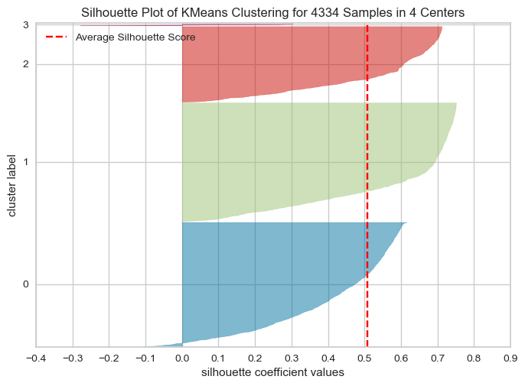
K Means
Silhouette Visualizer

Slide 16
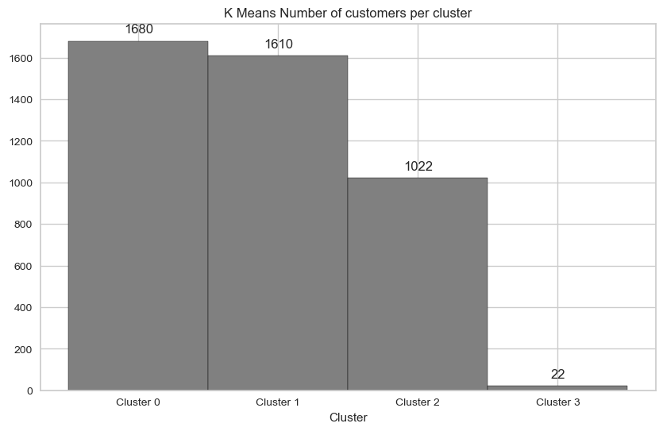
K Means
Predicted Clusters

Slide 17
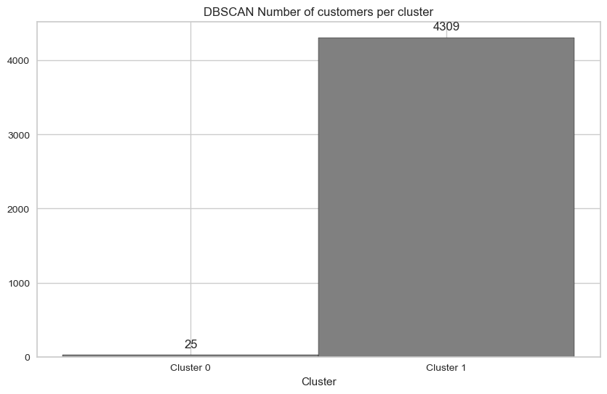
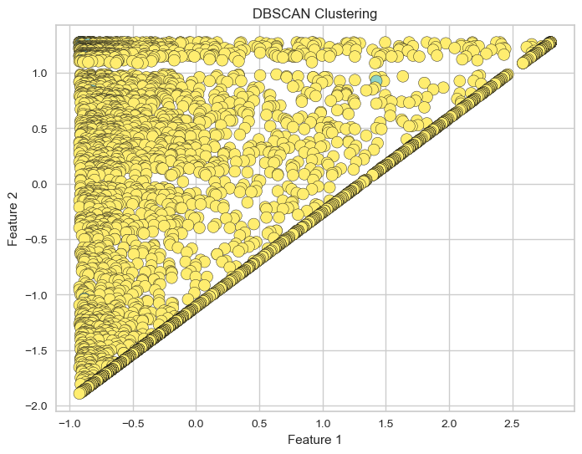
DBSCAN

Slide 18
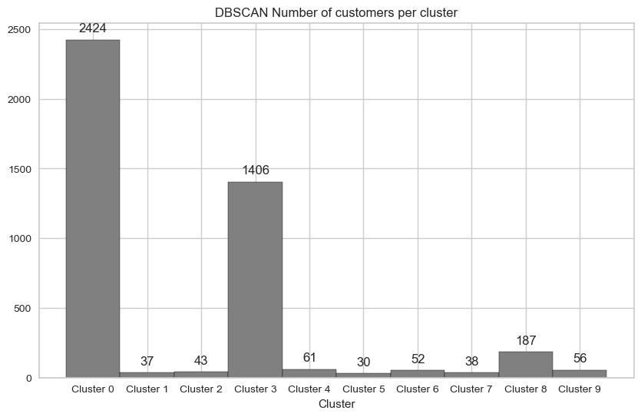
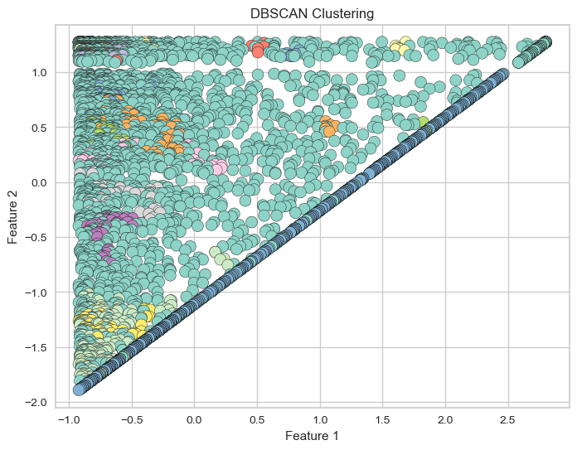
DBSCAN

Slide 19
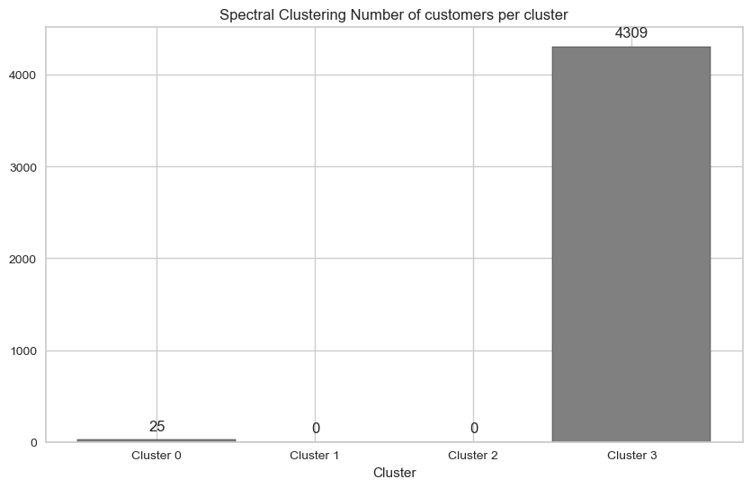
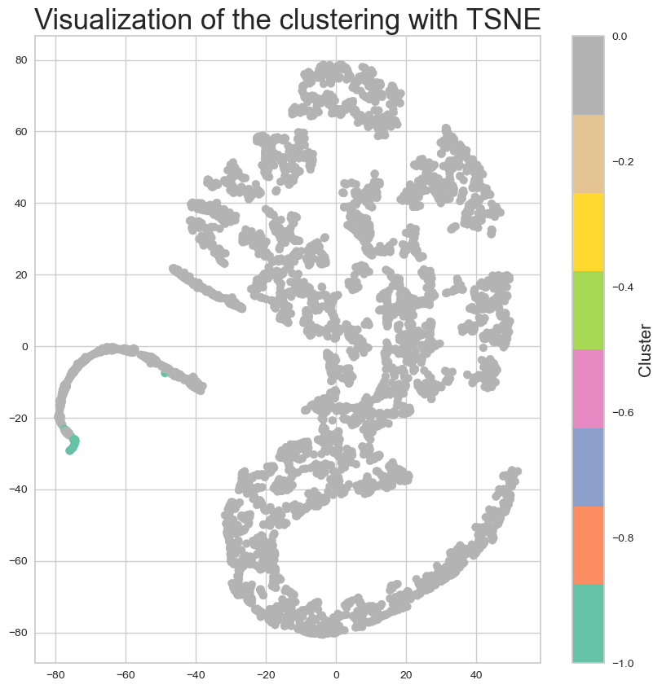
Spectral Clustering

Slide 20
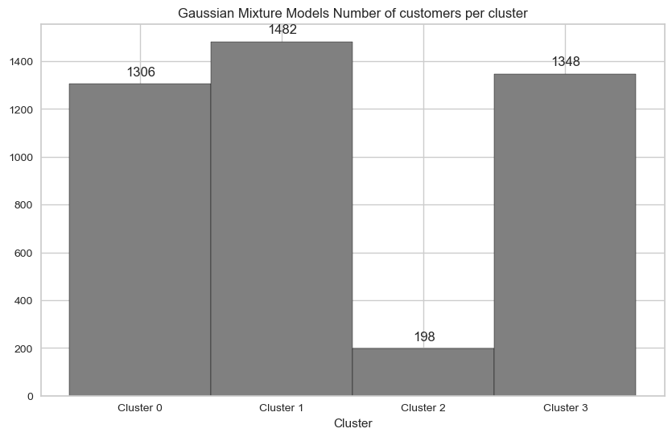
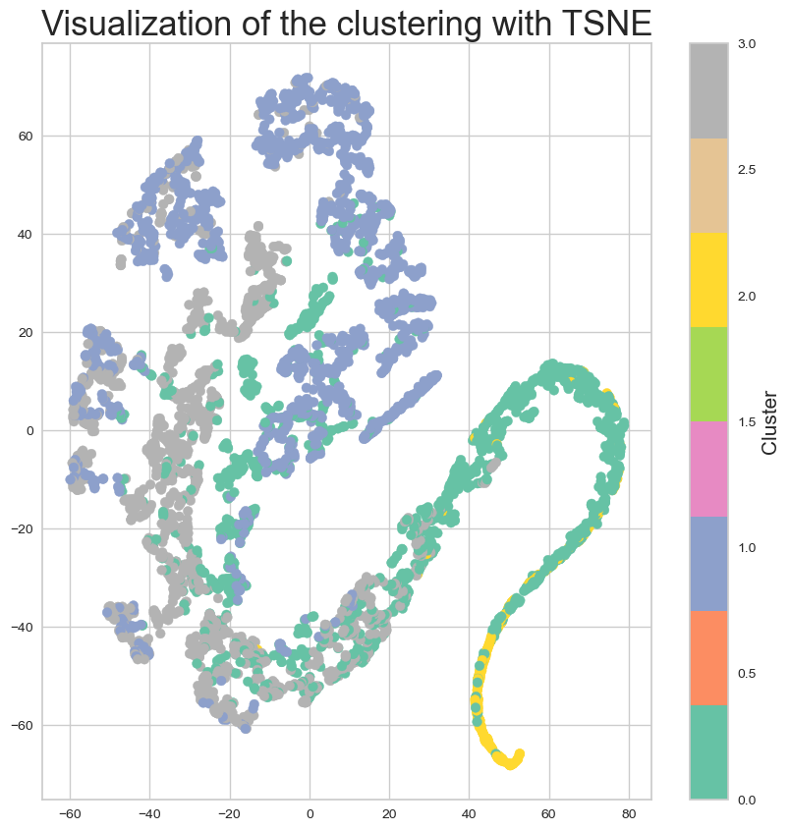
Gaussian Mixture Model

Slide 21
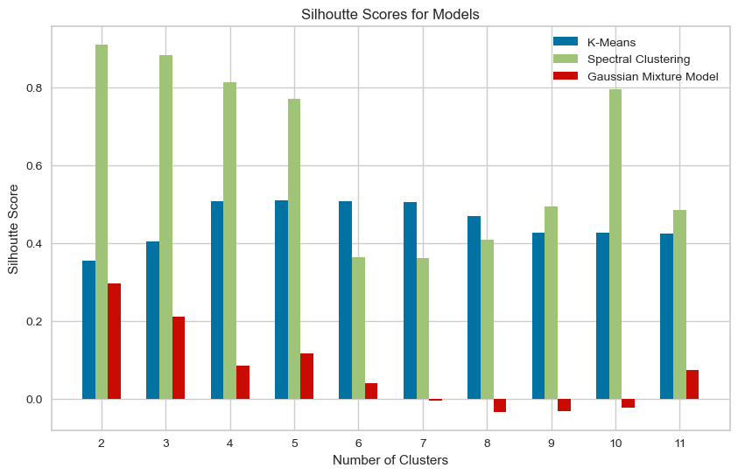
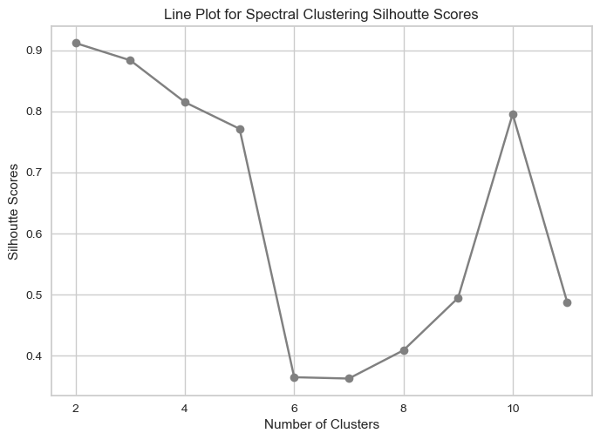
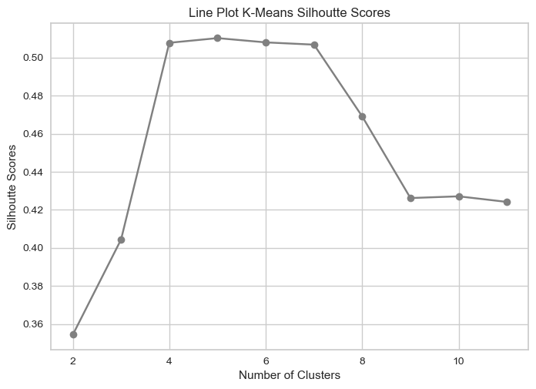
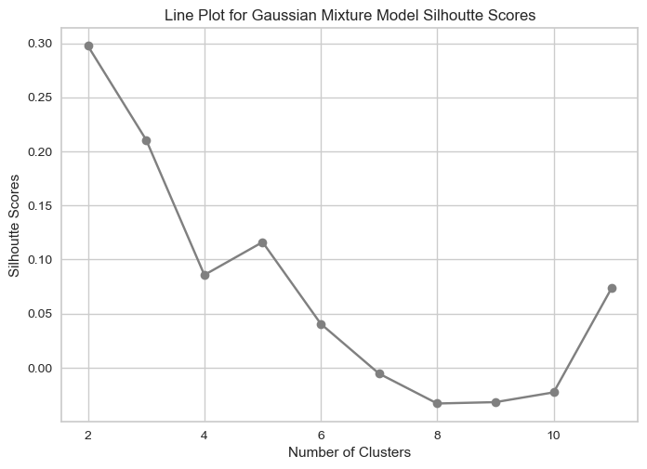
Evaluation

Slide 22
References
[1] https://www.kaggle.com/datasets/carrie1/ecommerce-data
[2] https://www.putler.com/rfm-analysis/#What_is_RFM_recency_frequency_monetary_analysis

Slide 23


